Slide 1

Heart Disease Prediction
This presentation explores various machine learning models for predicting heart disease. We will cover data processing, model implementation, and performance comparison.
by BALLAR NEETHU KUMARI

Slide 2



Heart Disease Prediction: The Critical Need
1
Global Health Crisis
2
Complex Risk Factors
Heart disease is a leading cause of death worldwide. Early detection can save lives.
Numerous genetic and lifestyle factors contribute. Identifying high-risk individuals is vital.
Healthcare Burden
Enhancing Early Care
Diagnosis and treatment strain healthcare systems. Proactive prediction reduces this load.
Accurate prediction allows for timely interventions. This significantly improves patient outcomes.

Slide 3

Data Overview and Preprocessing
1
Dataset Loading
The heart disease dataset was loaded using pandas.
It contains 303 entries and 14 columns.
2
Data Cleaning
No null values were found in the dataset.
Duplicate entries were identified and removed.

Slide 4
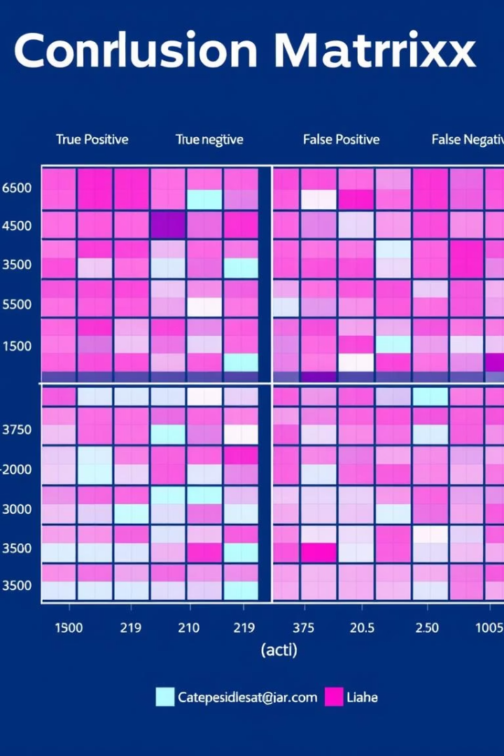
Logistic Regression Model
1
Model Training
2
Training Accuracy
Logistic Regression model was trained on the dataset.
Achieved 85.12% accuracy on the training data.
3
Test Accuracy
Achieved 81.96% accuracy on the test data.

Slide 5
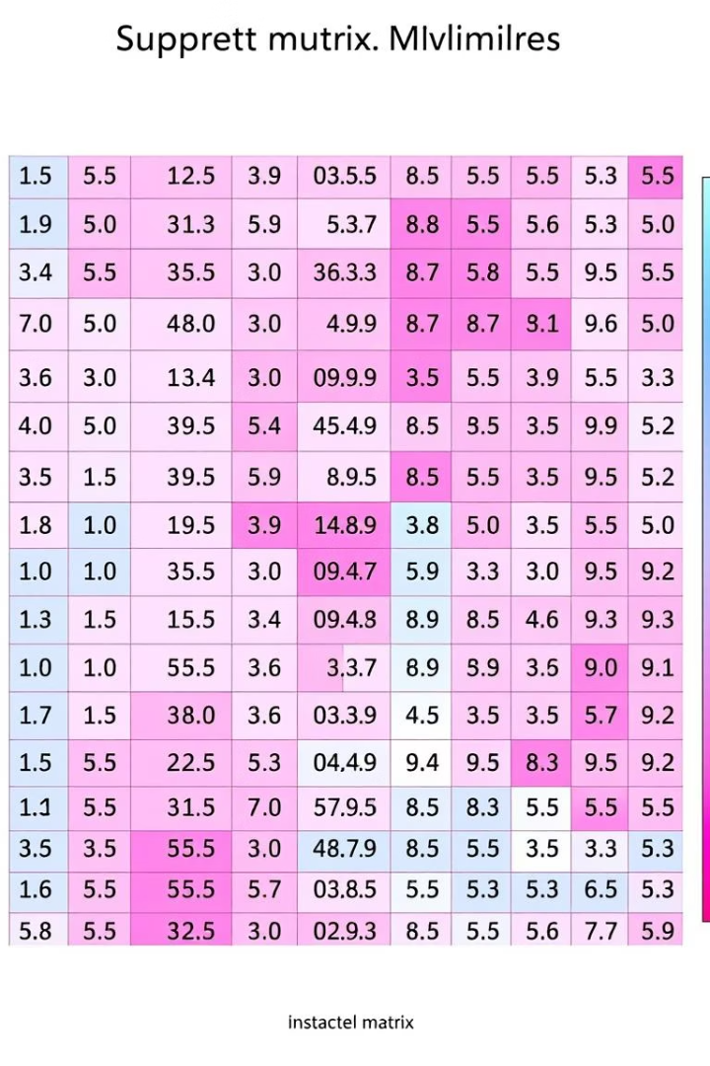
Support Vector Machine (SVM)
SVM Implementation
Training Performance
A Support Vector Machine with a linear kernel was used.
The training accuracy was 85.12%.
Test Performance
The test accuracy was 81.96%.

Slide 6



Ensemble Models: Random Forest & Gradient Boosting
Random Forest
Gradient Boosting
Training accuracy: 100%
Training accuracy: 100%
Test accuracy: 80.32%
Test accuracy: 78.69%

Slide 7




Naive Bayes and K-Nearest Neighbors
Gaussian Naive Bayes
KNeighbors Classifier
Training accuracy: 80.99%
Training accuracy: 76.85%
Test accuracy: 78.69%
Test accuracy: 67.21%

Slide 8
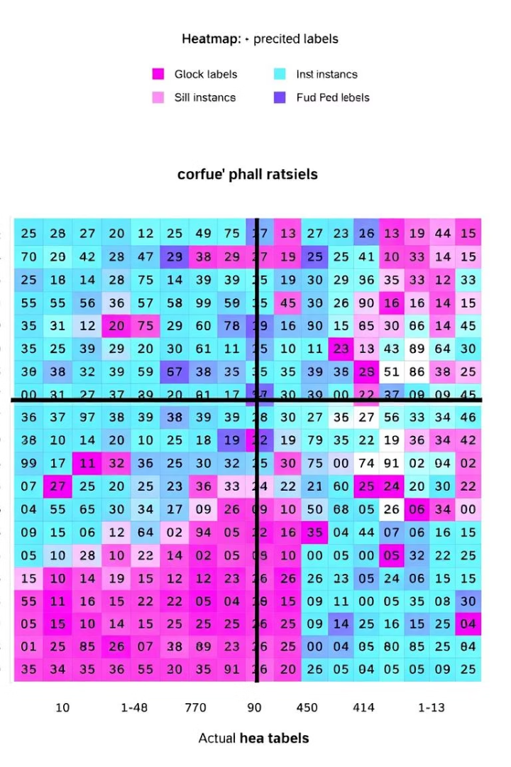



Decision Tree Classifier
Model Setup
Decision Tree Classifier initialized with random state 42.
Training Accuracy
Achieved 100% accuracy on the training data.
Test Accuracy
Achieved 73.77% accuracy on the test data.

Slide 9
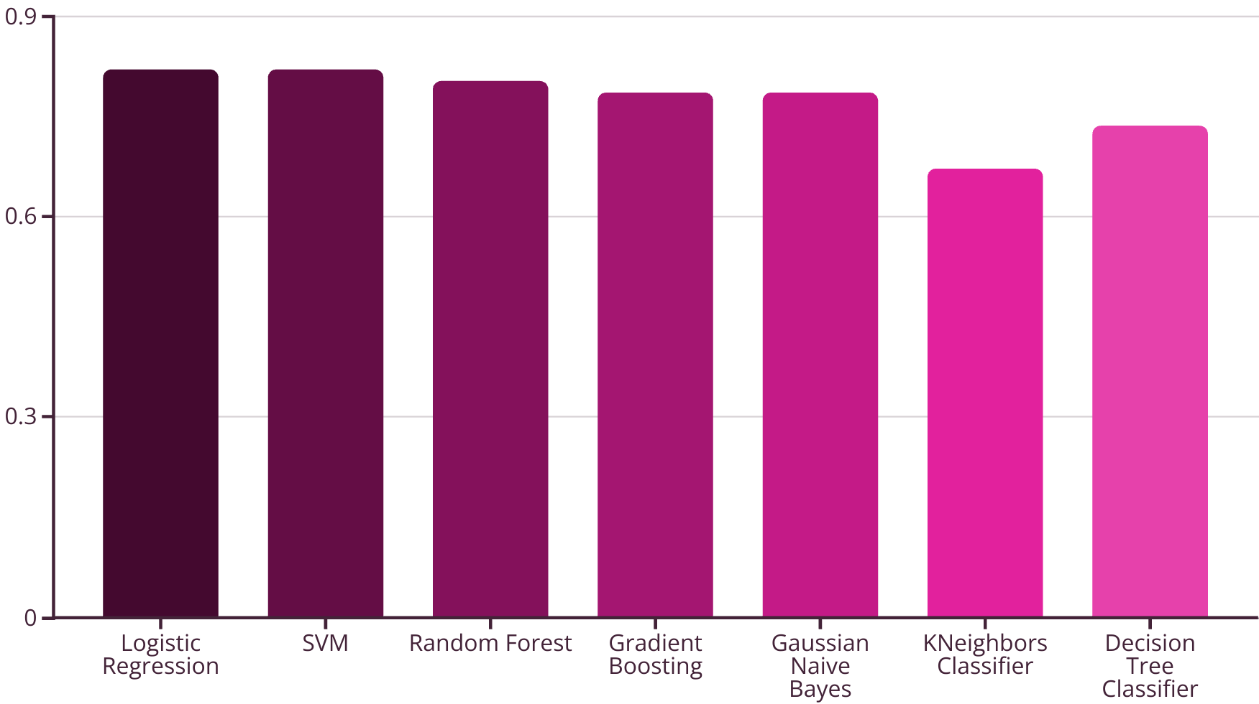
Model Accuracy Comparison

Slide 10

Thank You
Your attention is appreciated. This project demonstrated effective heart disease prediction using various machine learning models.
Early Detection Focus
Promising Results
Future Enhancements
Accurate models support proactive patient care. Early detection can significantly save lives.
Logistic Regression showed strong baseline accuracy. Ensemble models like Random Forest achieved high training accuracy.
Further research can explore advanced deep learning. Integrating more diverse patient data could boost performance.

